Slide 1
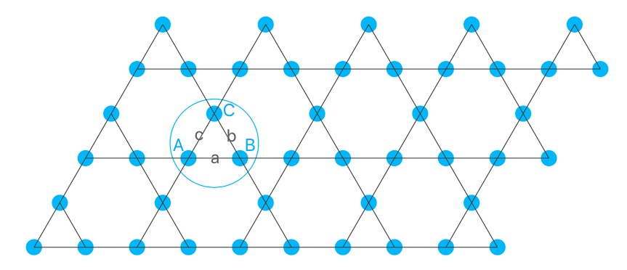
kagome data

Slide 2
Content
Previous studies
The results of t/J=3 t2/t=0.7
Electron density
Superconductivity correlation
The results of t/J=0.5 1 2 5 7 10
The results of t/J=3
t2/t=- ( 0.1 — 0.7 )
t2/t=0 J2=- ( 0.1 — 0.7 )
t2/t=0.3 J2=- ( 0.0 — 0.7 )
t2/t=0.3 J2=- ( 0.0 — 0.7 )
……

Slide 3
Doping quantum spin liquids on the Kagome lattice
March 2021. Cheng Peng, Yi-Fan Jiang
Content
We review recent density-matrix renormalization group (DMRG) studies of lightly doped quantum spin liquids (QSLs) on the kagome lattice
Section II Doping gapped spin liquid
lightly doped QSL of the AFM Heisenberg model on the kagome in the context of the t-J model
Results by introducing additional second-neighbor electron hopping terms
Section III Doping critical spin liquid
lightly doped critical spin liquid of the AFM XY model on the kagome lattice
Section IV Doping chiral spin liquid
Result
While a number of distinct conducting phases, including high temperature superconductivity, have been theoretically anticipated we find instead a tendency toward fractionalized insulating charge-density-wave (CDW) states.
While the superconducting correlations are short-ranged, they can be significantly enhanced by second-neighbor electron hopping

Slide 4
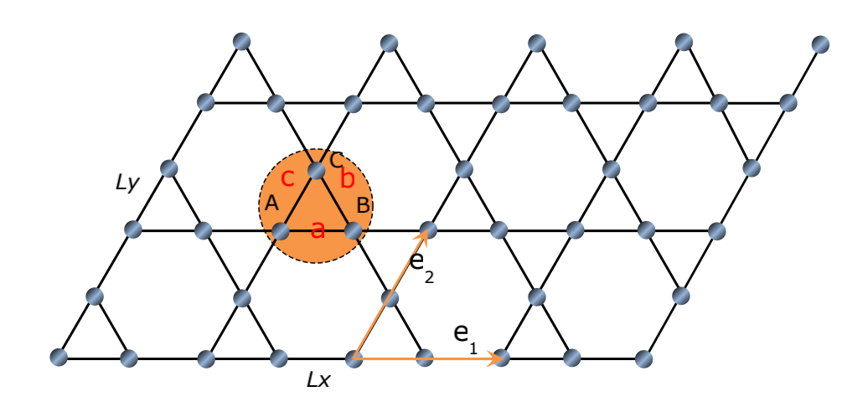
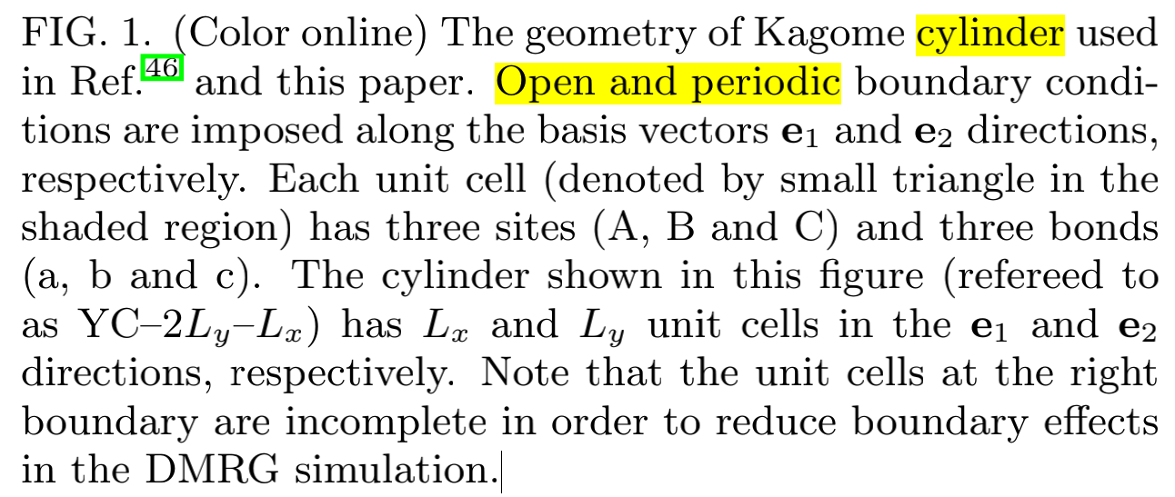
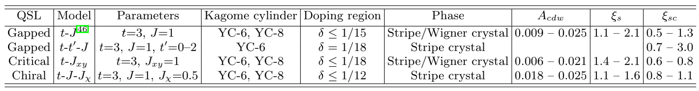

Slide 5
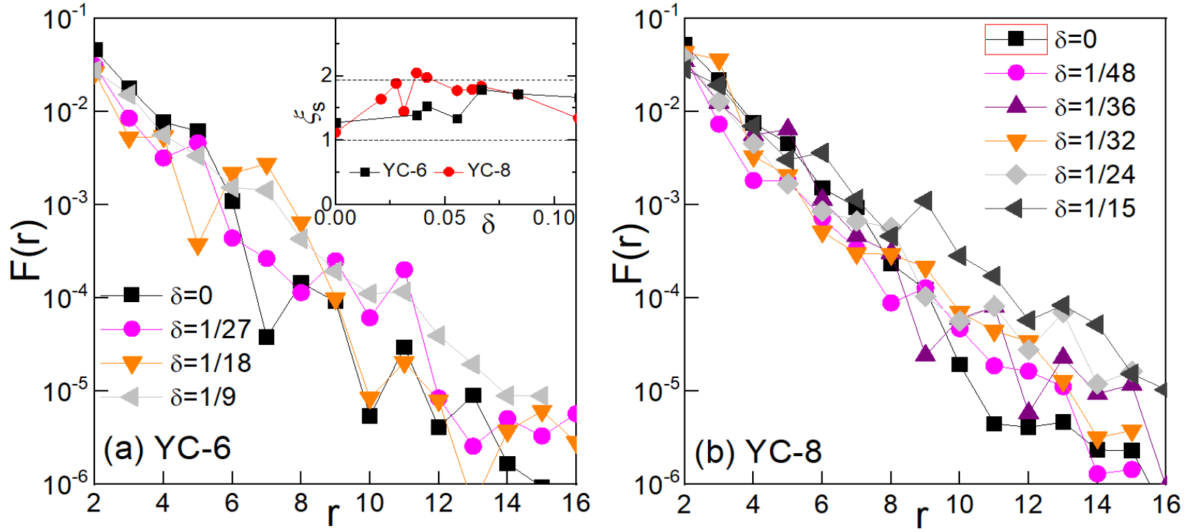
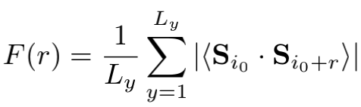
I Doping gapped spin liquid ~ spin-spin correlation functions
Remarkably insensitive to doping concentration δ
Independent of YC6/YC8
F(r) decays exponentially at long distances and can be well fitted by an exponential function F(r) ∼ e^{−r}/ξ_{s} with short correlation lengths ξ_{s}=1∼ 2 lattice spacings

Slide 6
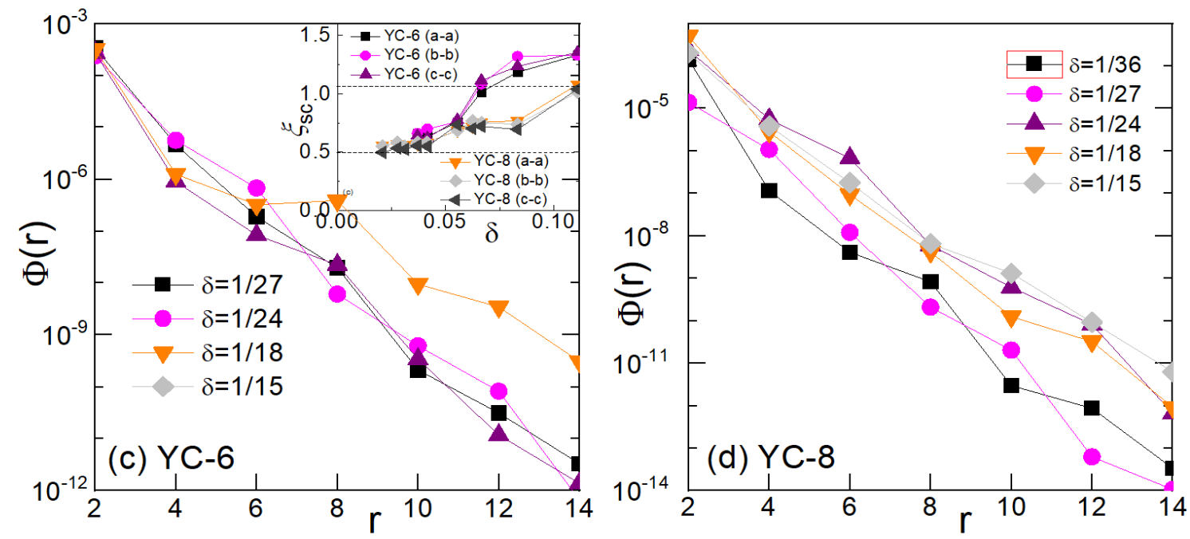
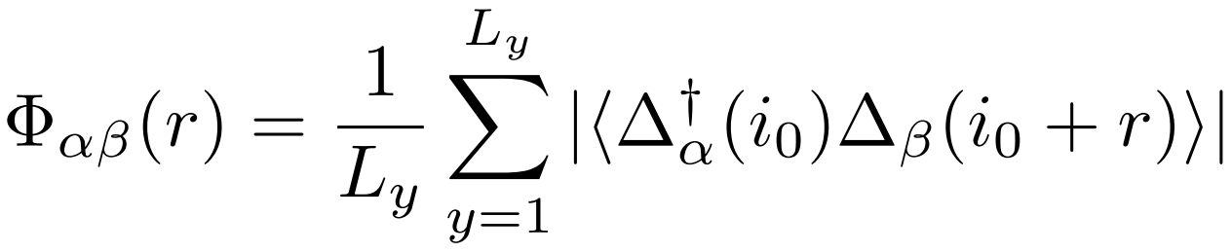
I Doping gapped spin liquid ~ superconducting correlations
All the SC correlations Φ_{αβ}(r) decay exponentially at long distances for both YC-6 and YC-8 cylinders and can be well fitted by the exponential function Φ(r) ∼e^{-r/ξsc}
The SC correlation lengths ξ_{sc} = 0.5 ∼ 1.3 are small for all doping concentrations 0 < δ ≤ 11%

Slide 7
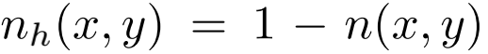
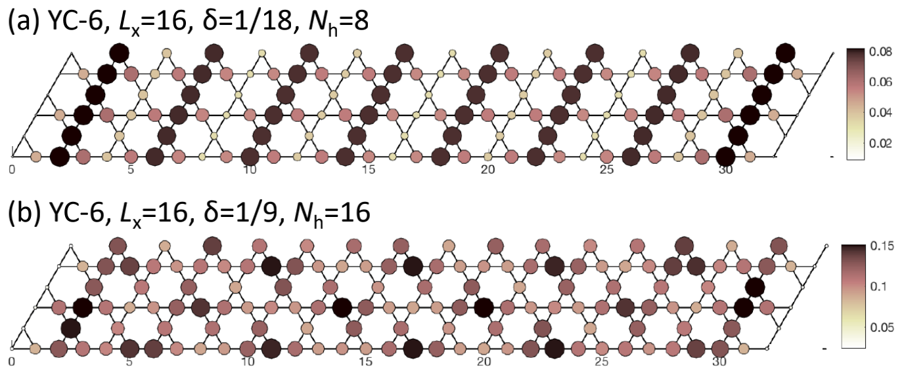
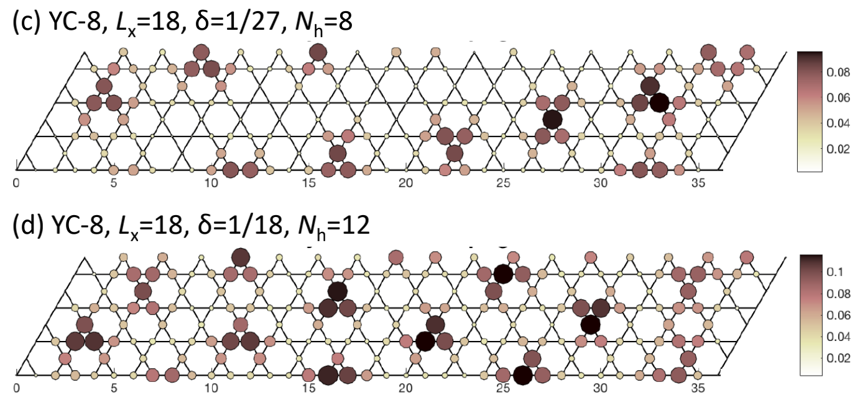
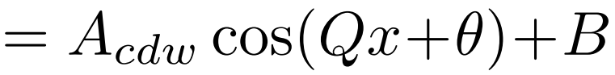
I Doping gapped spin liquid ~ charge density (hole)
Long-range CDW order
A clear CDW ordering is observed, although its pattern, i.e., unidirectional stripe or 2D crystal, depends on either the lattice geometry and doping concentration
The number of emergent unit cells is equal to the number of doped holes at all doping concentrations, showing that there are no Cooper pairs
A_{cdw} remains finite in the Lx = ∞ limit (0.009 – 0.025)

Slide 8
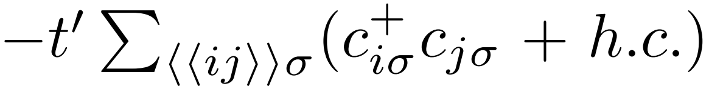
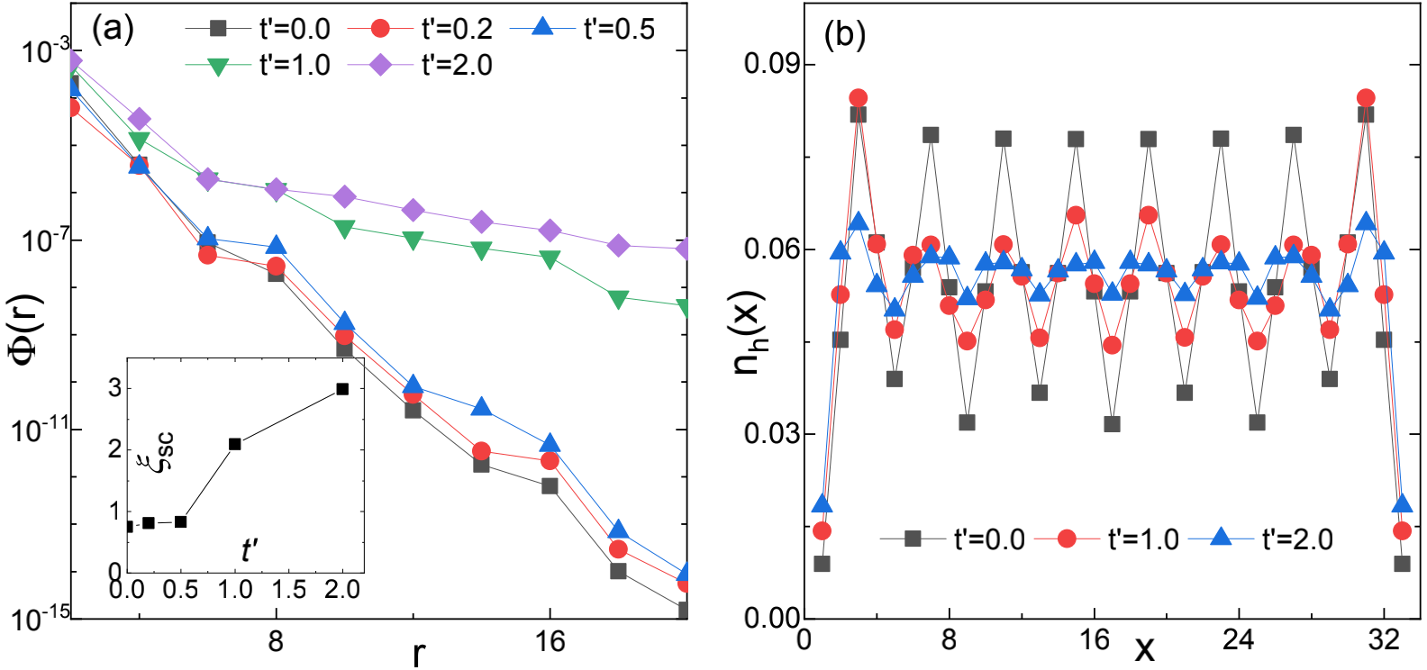
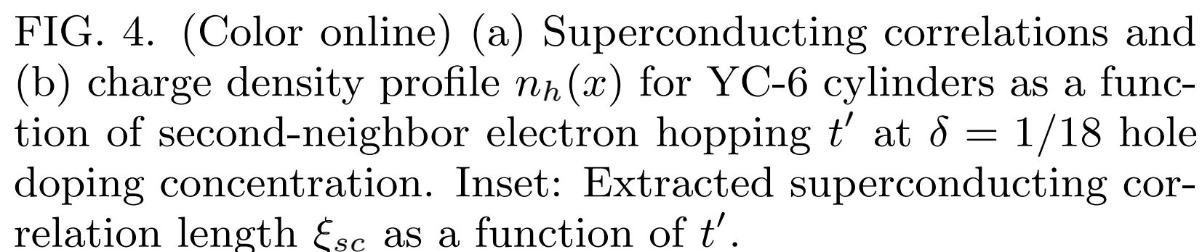
I Doping gapped spin liquid ~ effect of second-neighbor hopping t'
The value of Φ(r) can be enhanced by many orders of magnitudes when t' is comparable with J and even more for larger t' (t=3, J=1)
The SC correlation length becomes significantly longer with the increase of t'
Quasi-long-range superconductivity has not yet been realized on the Kagome lattice
The oscillation amplitude A_{cdw} of nh(x) becomes significantly smaller as t' increases

Slide 9
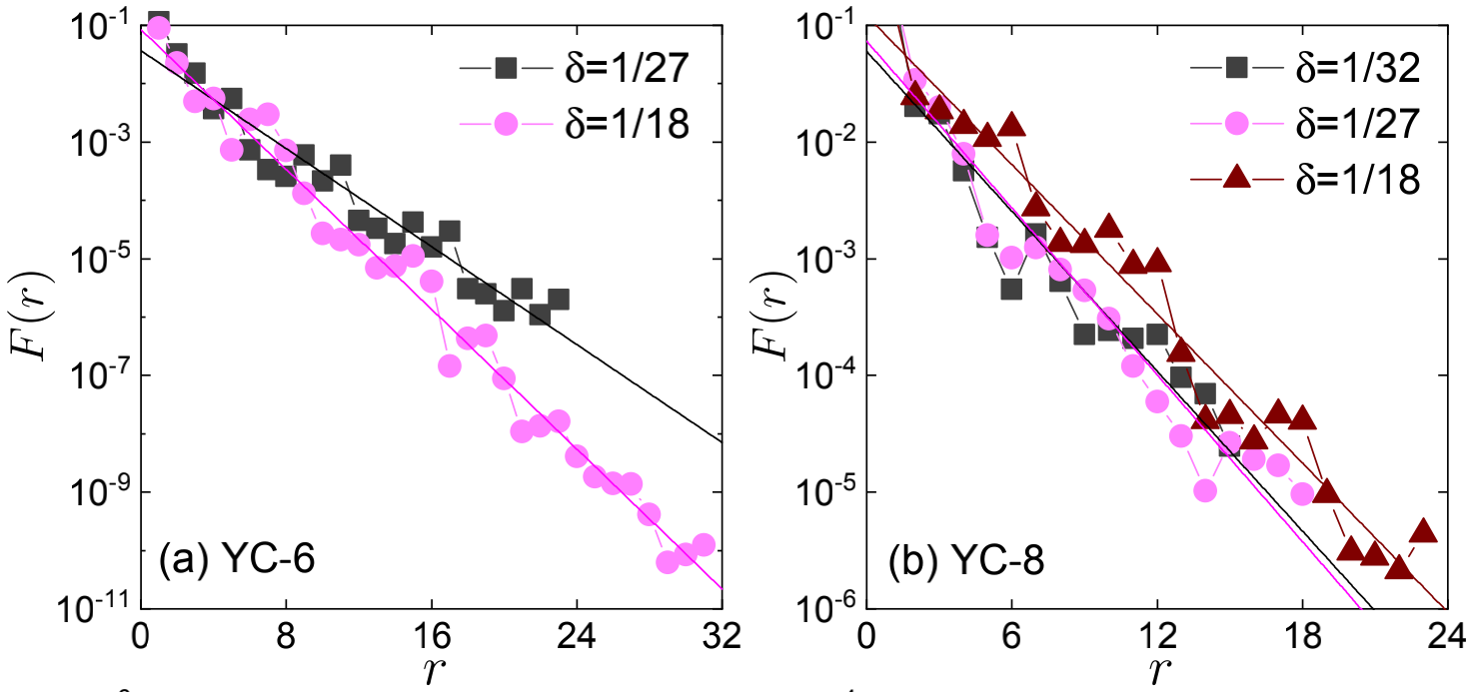
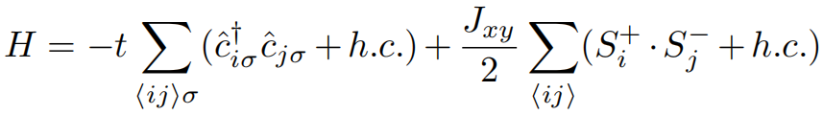
II Doping critical spin liquid ~ spin-spin correlation functions
For all these cases, we find that F(r) decays exponentially at long distances and can be well fitted by an exponentially falling function F(r) ∼ e^{-r/ξs}
Although ξ_{s} slightly depends on δ and lattice geometry, it remains finite and small, e.g., ξ_{s} = 1.45(3)–2.1(2) lattice spacings for YC-6 and YC-8 cylinders.
There is no (quasi-) long-range magnetic order in the lightly doped critical spin liquid on the Kagome lattice

Slide 10
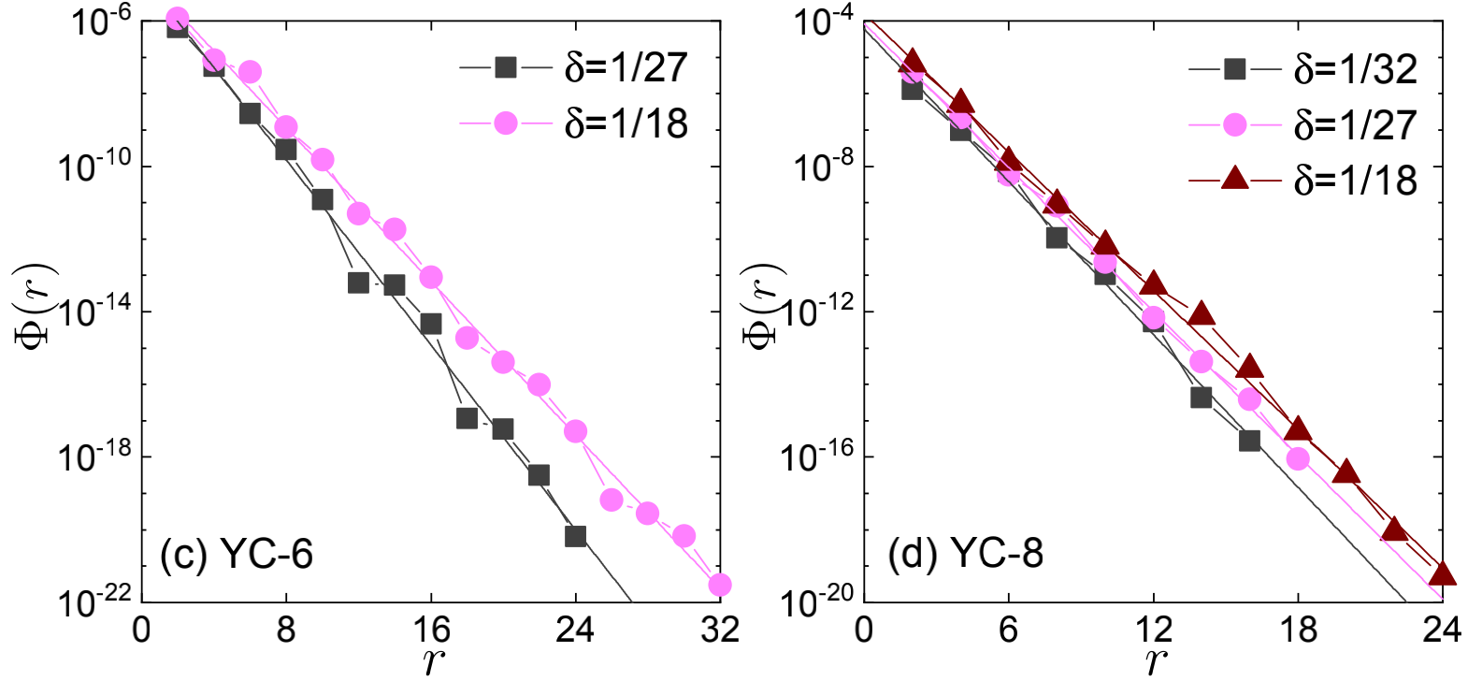
II Doping critical spin liquid ~ superconducting correlations
All types of the SC correlations decay exponentially at long distances for both YC-6 and YC-8 cylinders
The SC pair-pair correlations Φ_{aa}(r) for three different doping concentrations can be well fitted by an exponential function Φ(r) ∼ e^{-r/ξsc} with short SC correlation length ξ_{sc} = 0.62(2)–0.82(1) lattice spacings
There is no (quasi-) long-range superconductivity in lightly doped critical spin liquid phase on the Kagome lattice

Slide 11
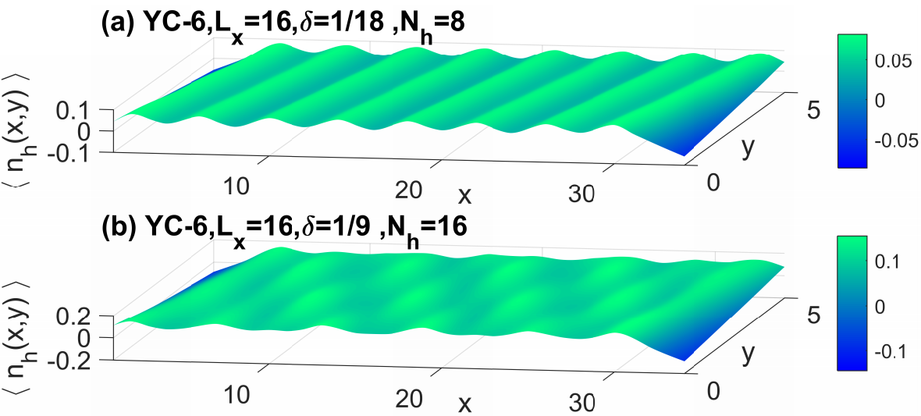
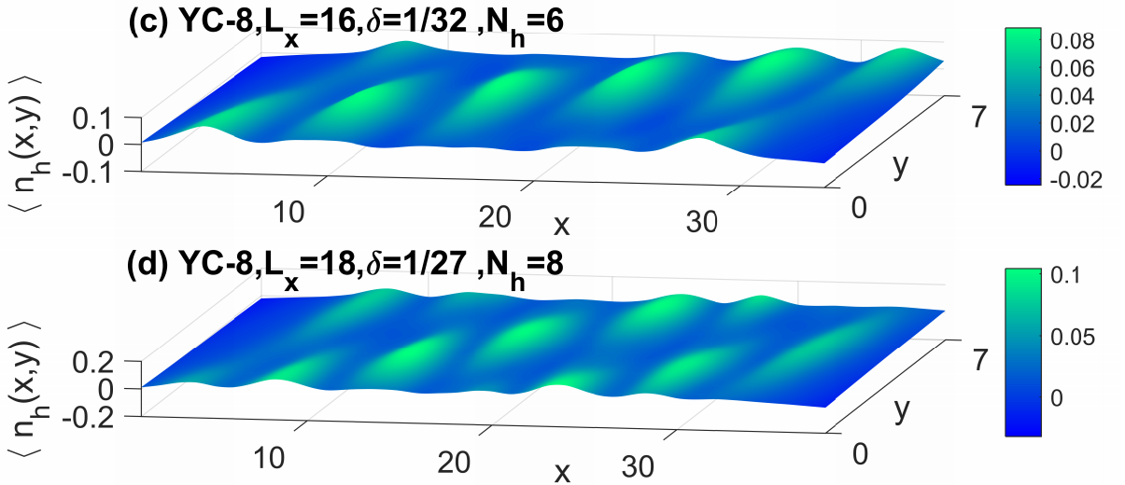
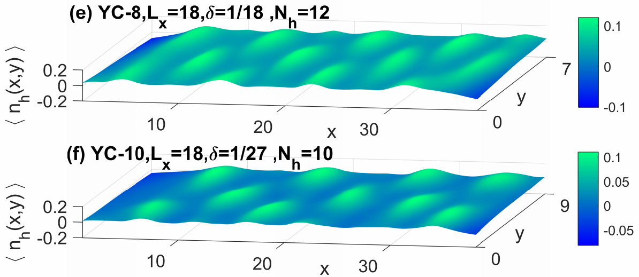
II Doping critical spin liquid ~ charge density (hole)
There is charge stripe (i.e., unidirectional CDW order) at low doping level, e.g., δ = 1/18 for YC-6 cylinders. For higher doping concentrations on YC-6 cylinders and lightly doped cases for both YC-8 and YC-10 cylinders, the CDW order is 2D
The number of the emergent unit cells is equal to the number of doped holes for all doping concentrations, which demonstrates the absence of Cooper pairs in this lightly doped critical spin liquid on the Kagome lattice

Slide 12
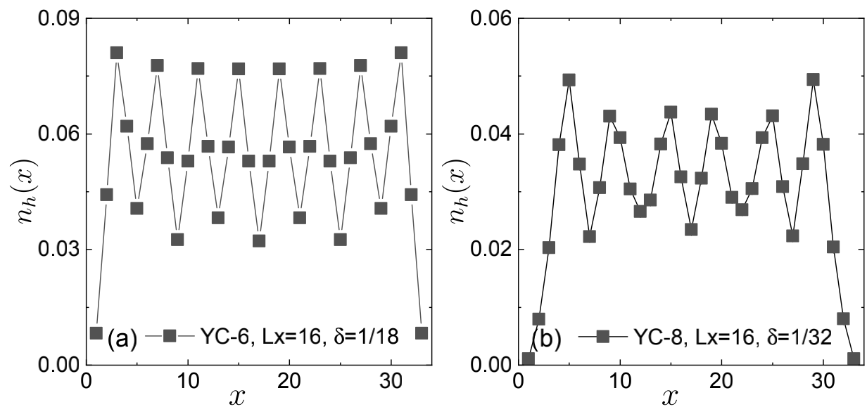
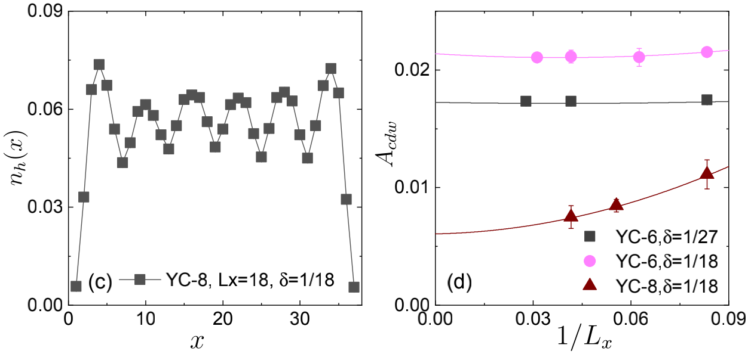
II Doping critical spin liquid ~ charge density (hole)
The presence of long-range CDW order is directly evidenced by the observed finite amplitude A_{cdw} in the long-cylinder limit L_{x} = ∞
The ground state of lightly doped critical spin liquid can also be considered as a CDW of spinless holons with spin charge separation, which is evidenced by the short-range spin-spin correlations and the absence of doping induced magnetic order

Slide 13
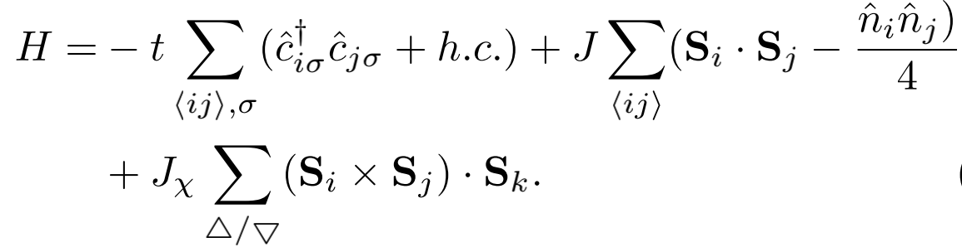
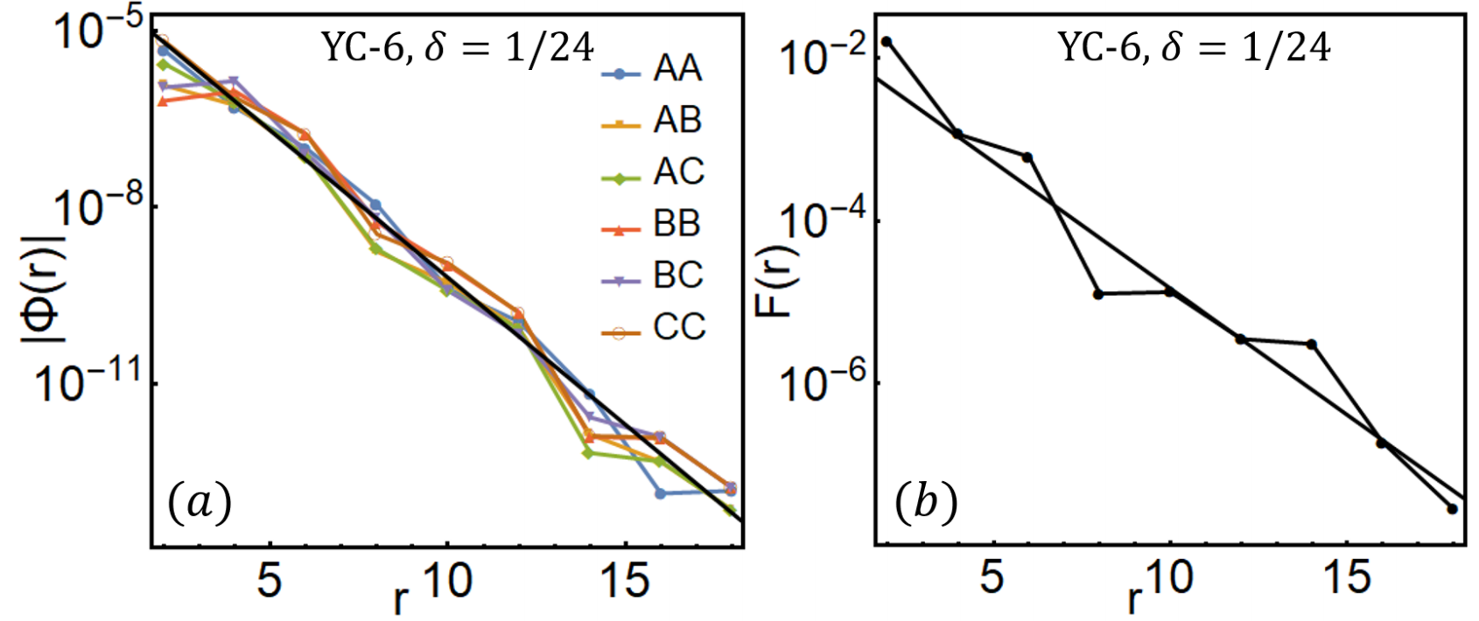
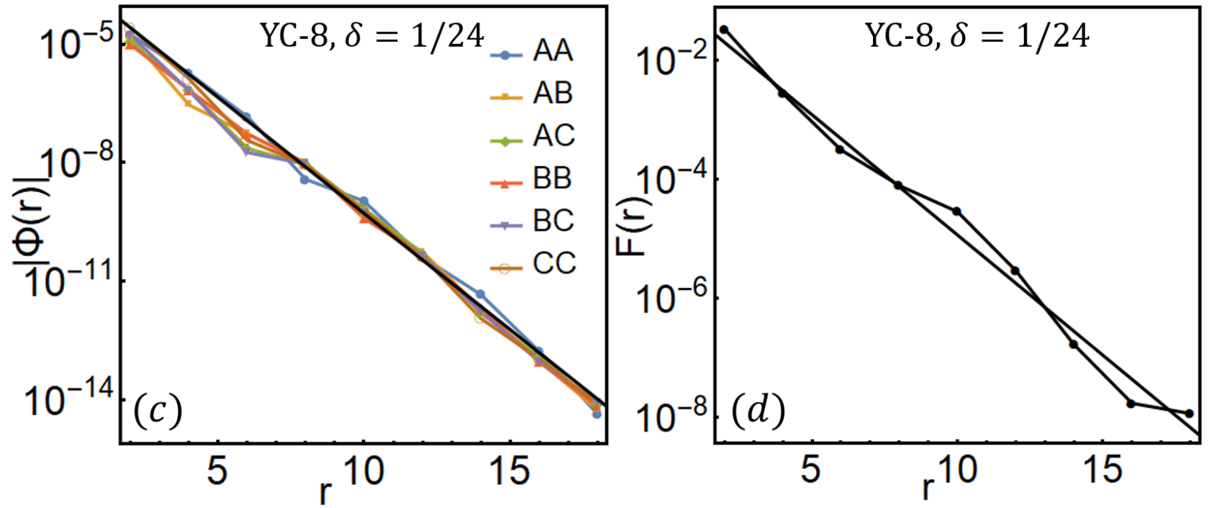
III Doping chiral spin liquid ~ spin-spin correlation functions and superconducting correlations
J = 1 t = 3 J_{χ}=0.5
At half-filling, Eq reduces to the J-J_{χ} model, which has a stable gapped CSL in a larger parameter region
For both YC-6 and YC-8 cases, the extracted SC correlation lengths are ξ_{sc} ∼ 0.8 unit cell, nearly independent on bond types αβ.
F(r) can be fitted by the exponential function F(r) ∼ e^{-r/ξs} with a short correlation length ξ_{s} ∼ 1.3 and ξ_{s} ∼ 1.1 unit cell for YC-6 and YC-8 cases, respectively

Slide 14
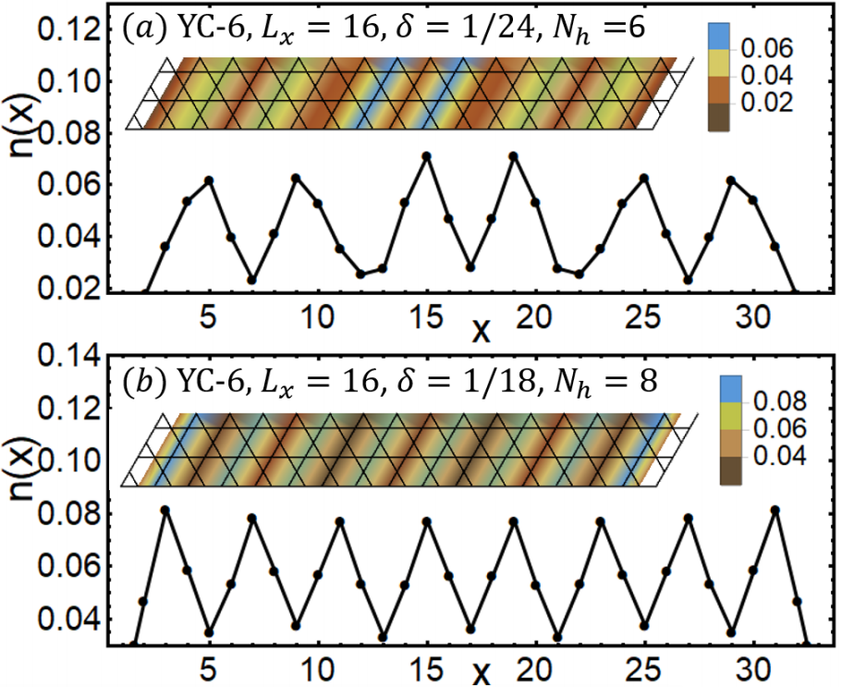
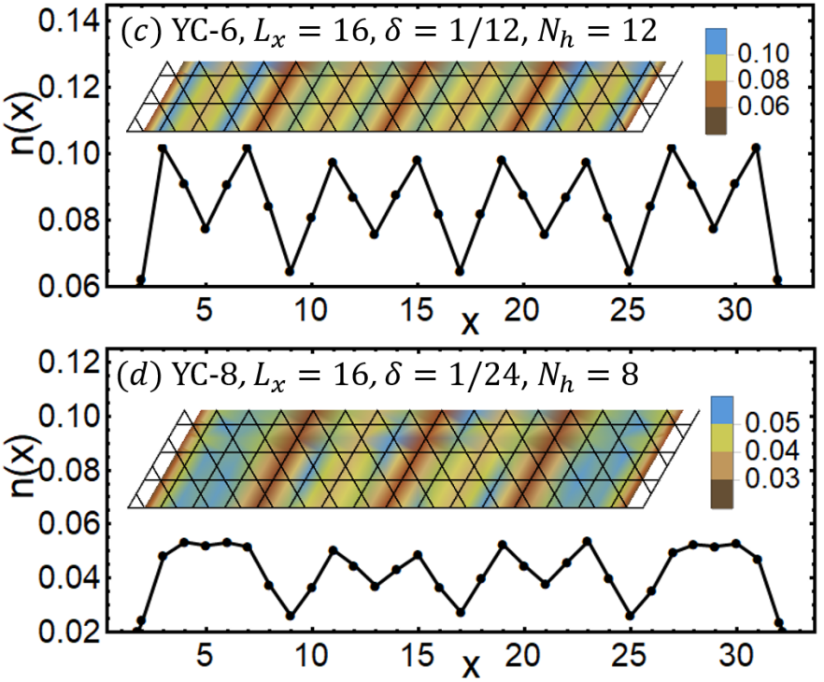
III Doping chiral spin liquid ~ charge density (hole)
While it is not very straightforward to establish the absence of hole pairs for 1/12 doping concentration in Fig.8(c), it is clear that for YC-6 cylinders with δ = 1/24 and 1/18 doping concentration as shown in Fig.8(a-b), the number of emergent unit cells is equal to the number of doped holes
Similar charge stripes with one doped hole are observed in the bulk of the YC-8 cylinder with δ = 1/24 doping concentration (Fig.8(d)), indicating that the charge stripes emerged from the doped CSL is robust as the systems become wider
n_{h}(x) has a strong spatial oscillation whose amplitude barely decays or even increases from the boundary to the bulk of the system. Therefore, while we cannot perform the finite-size extrapolation, it is very likely that such a stripe CDW order appears to be long-ranged in the Lx = ∞ limit for YC-6 and YC-8 cylinders
Moreover, there is no doping induced magnetic order, from which we could conclude that the ground state of the system forms a stripe crystal of spinless holons with spin-charge separation.

Slide 15
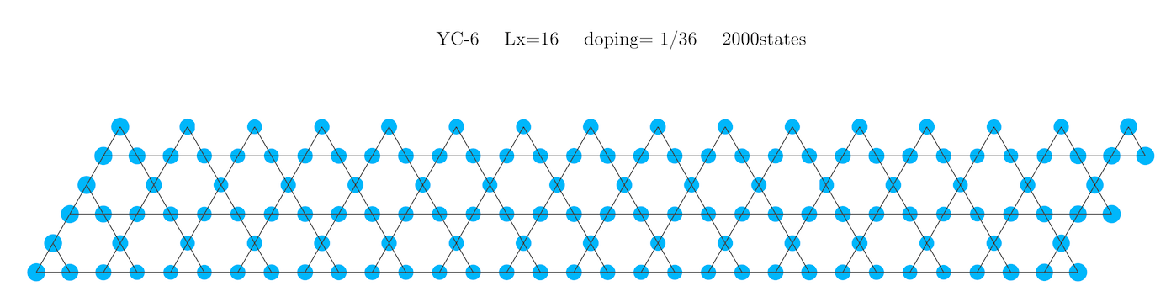
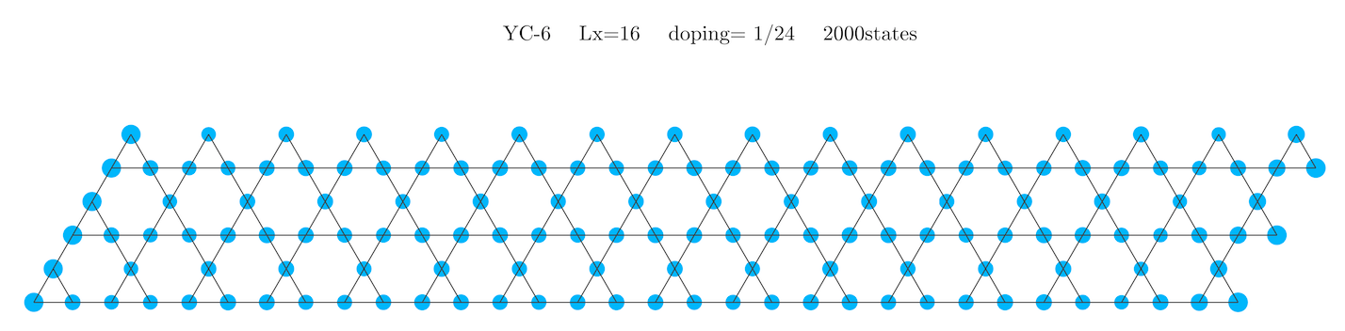
electron density (t1=3 J1=1 t2/t1=0.7 J2/J1=0.49)

Slide 16
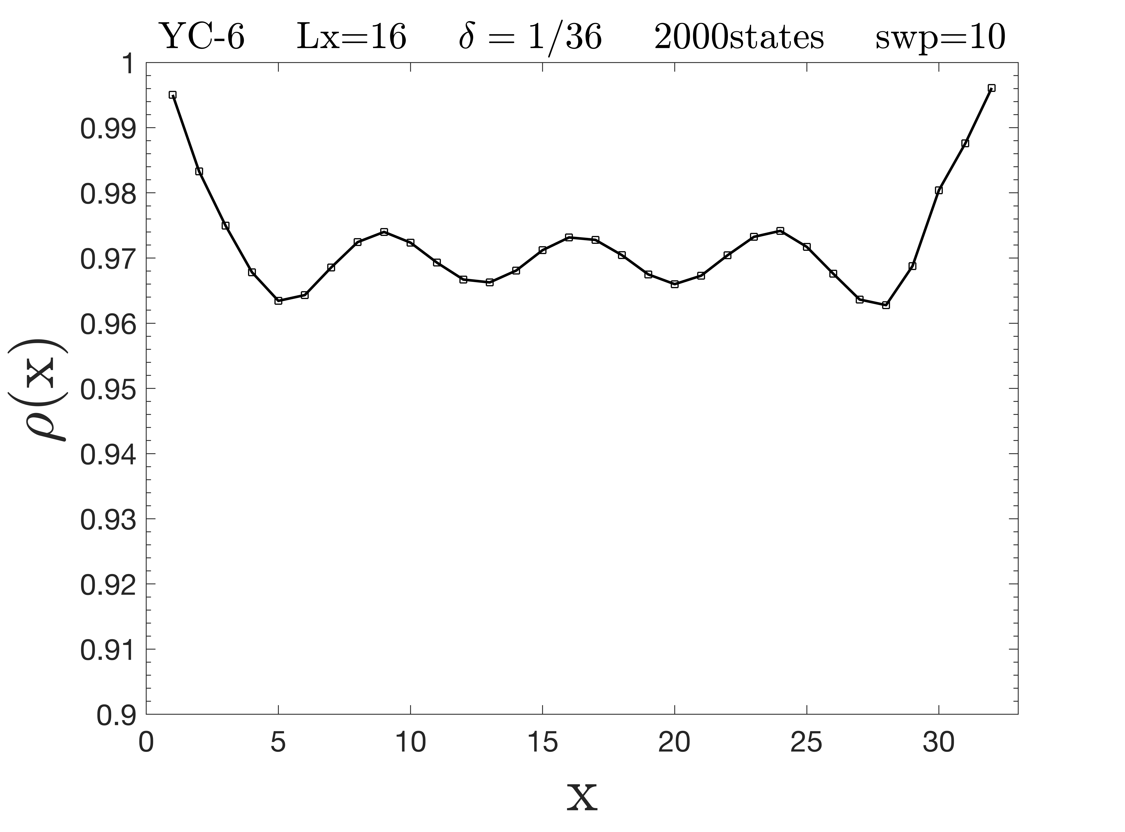
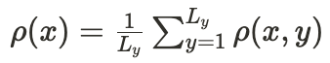
(includes both A and B sites)

Slide 17
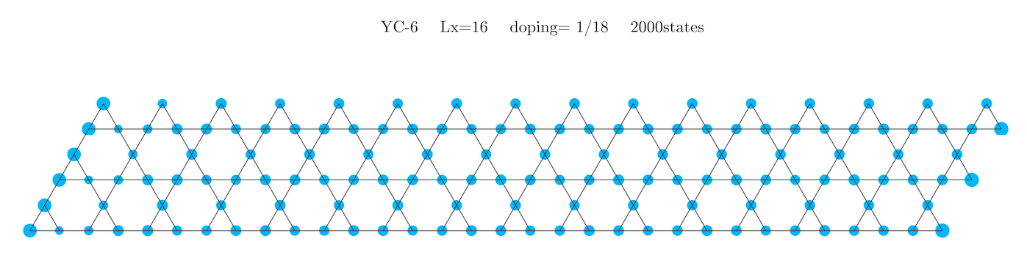
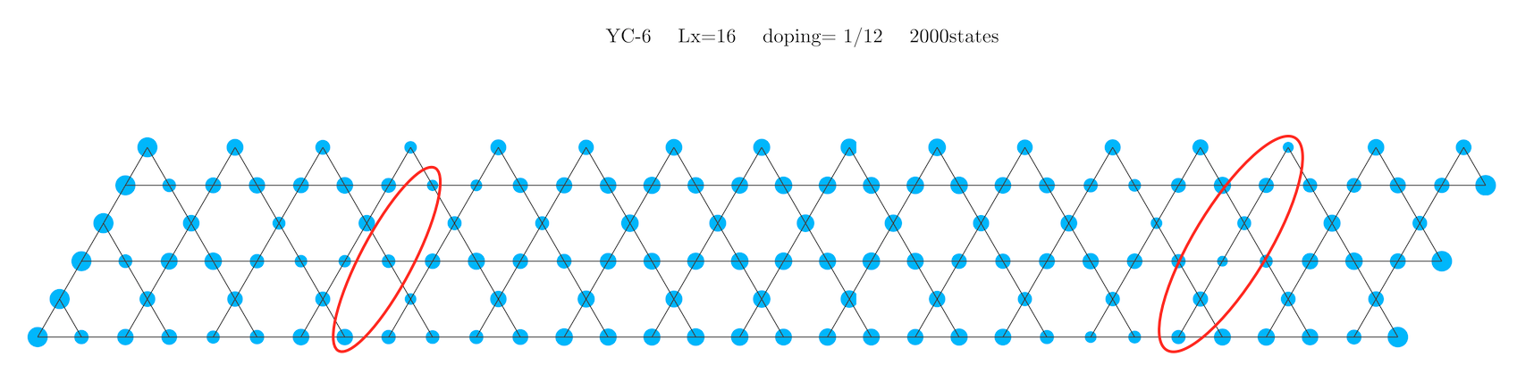

Slide 18
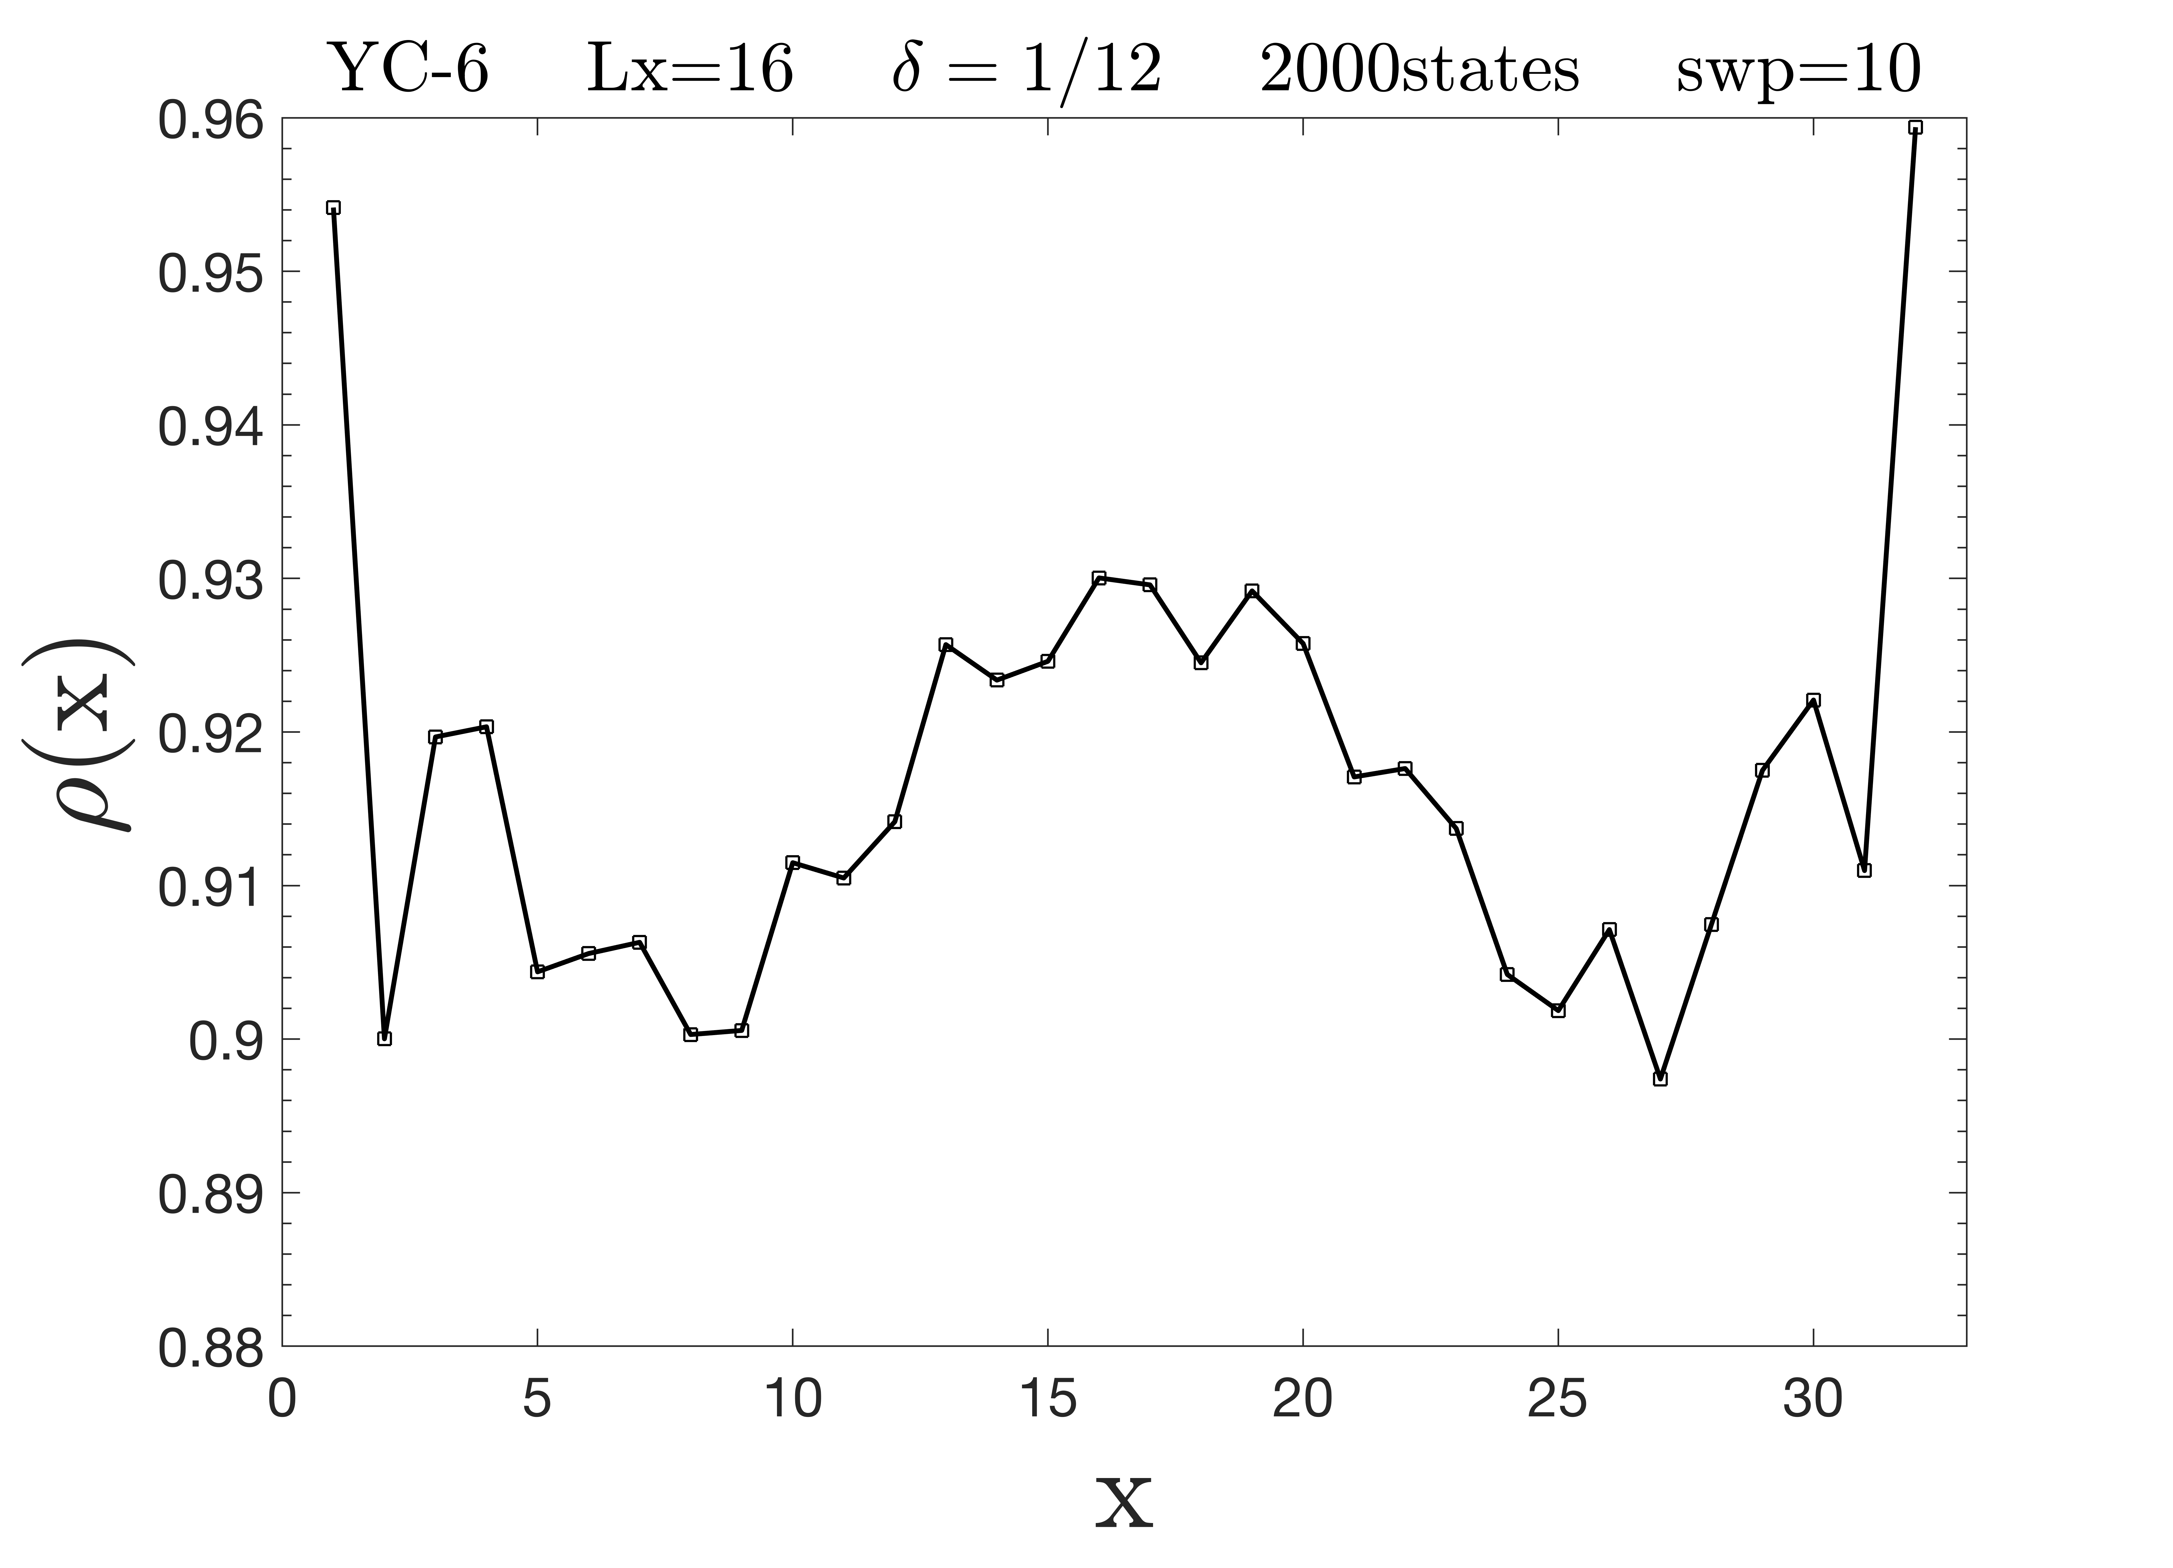

Slide 19
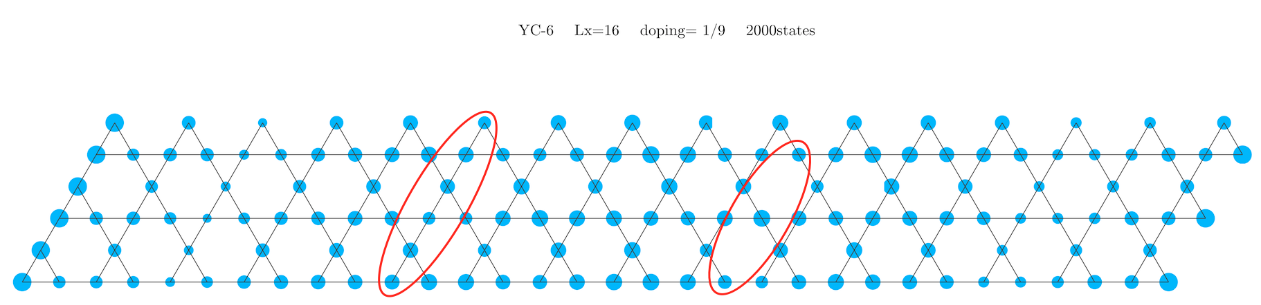
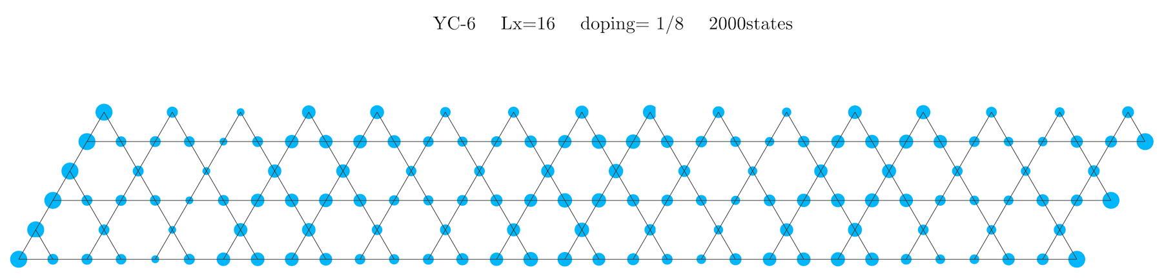

Slide 20
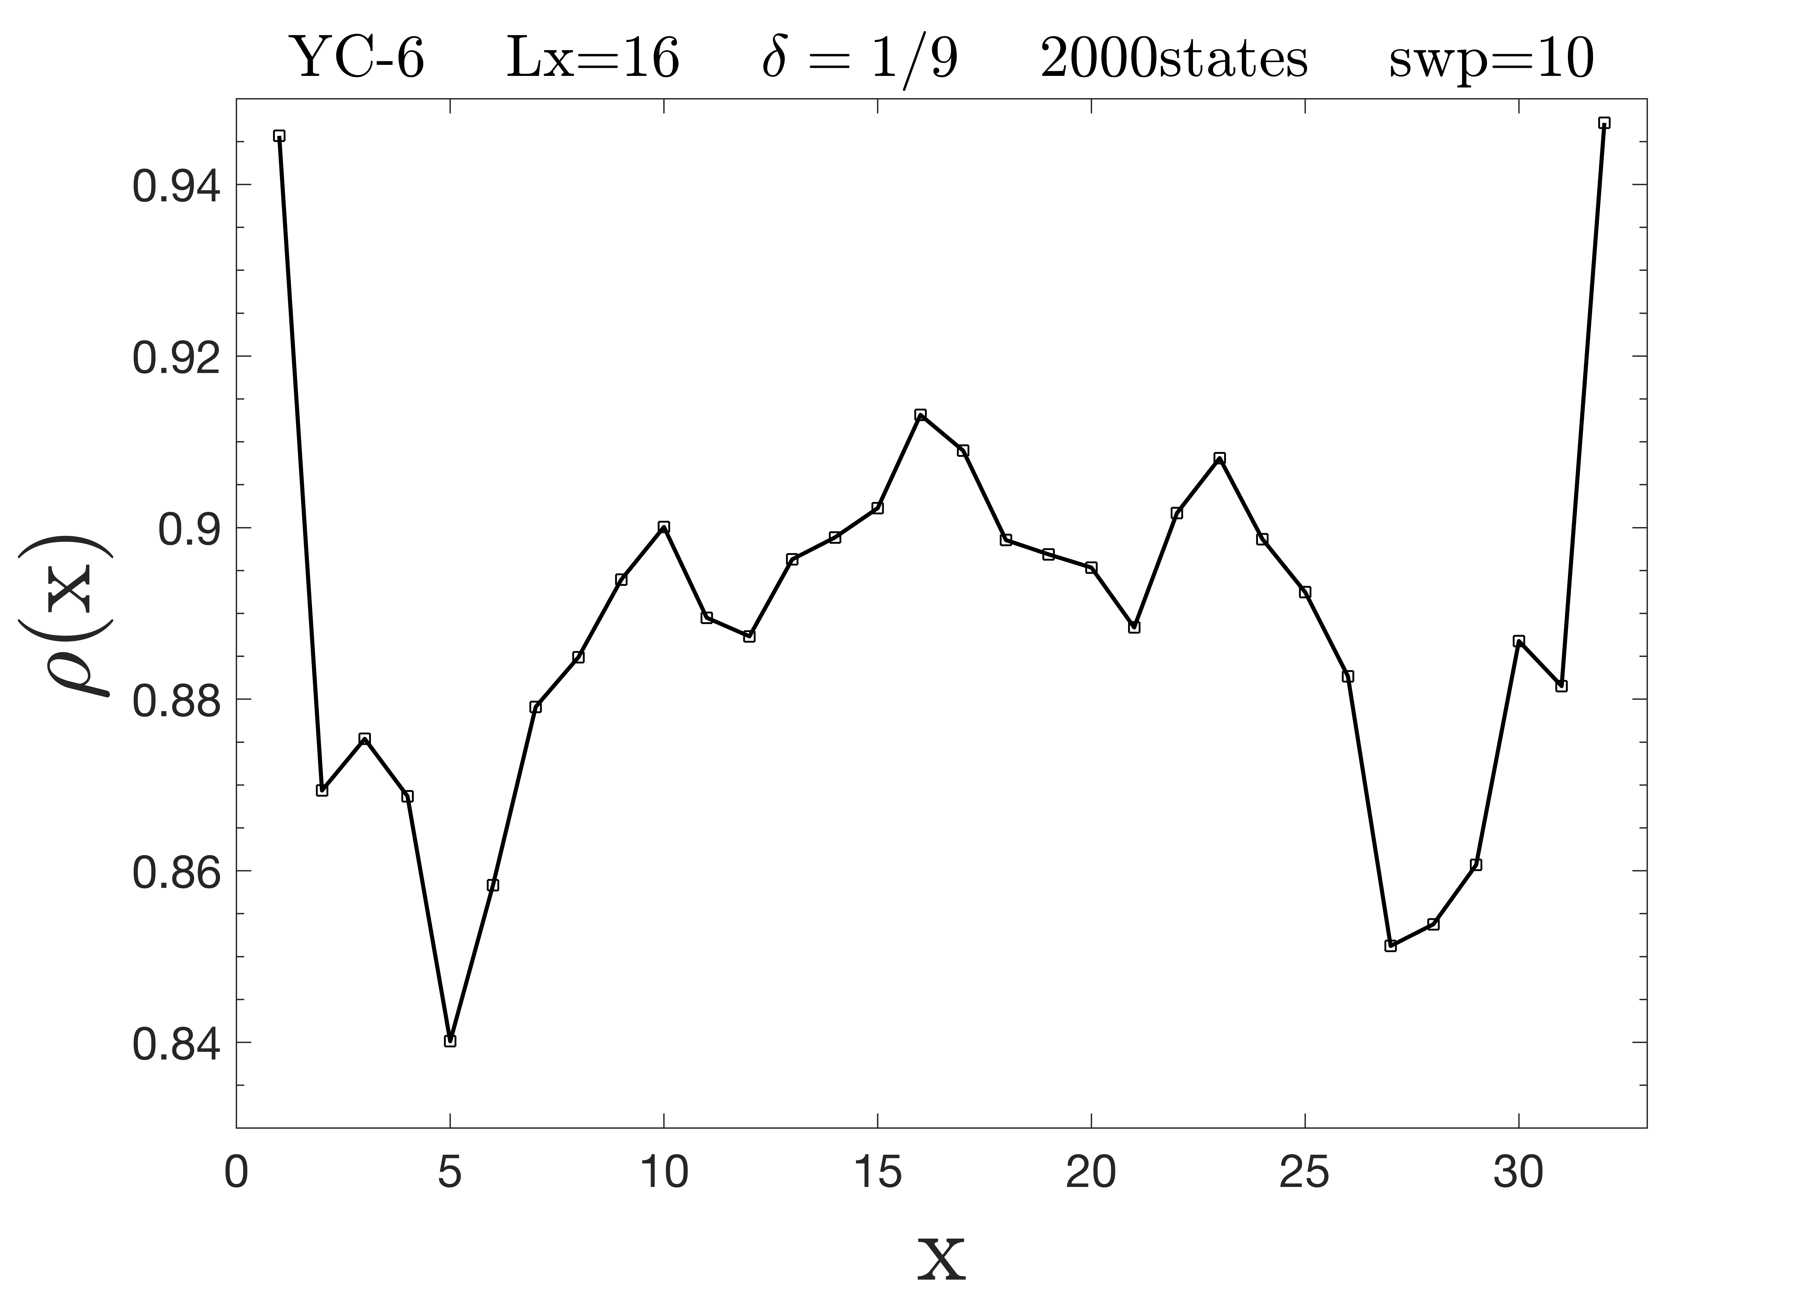
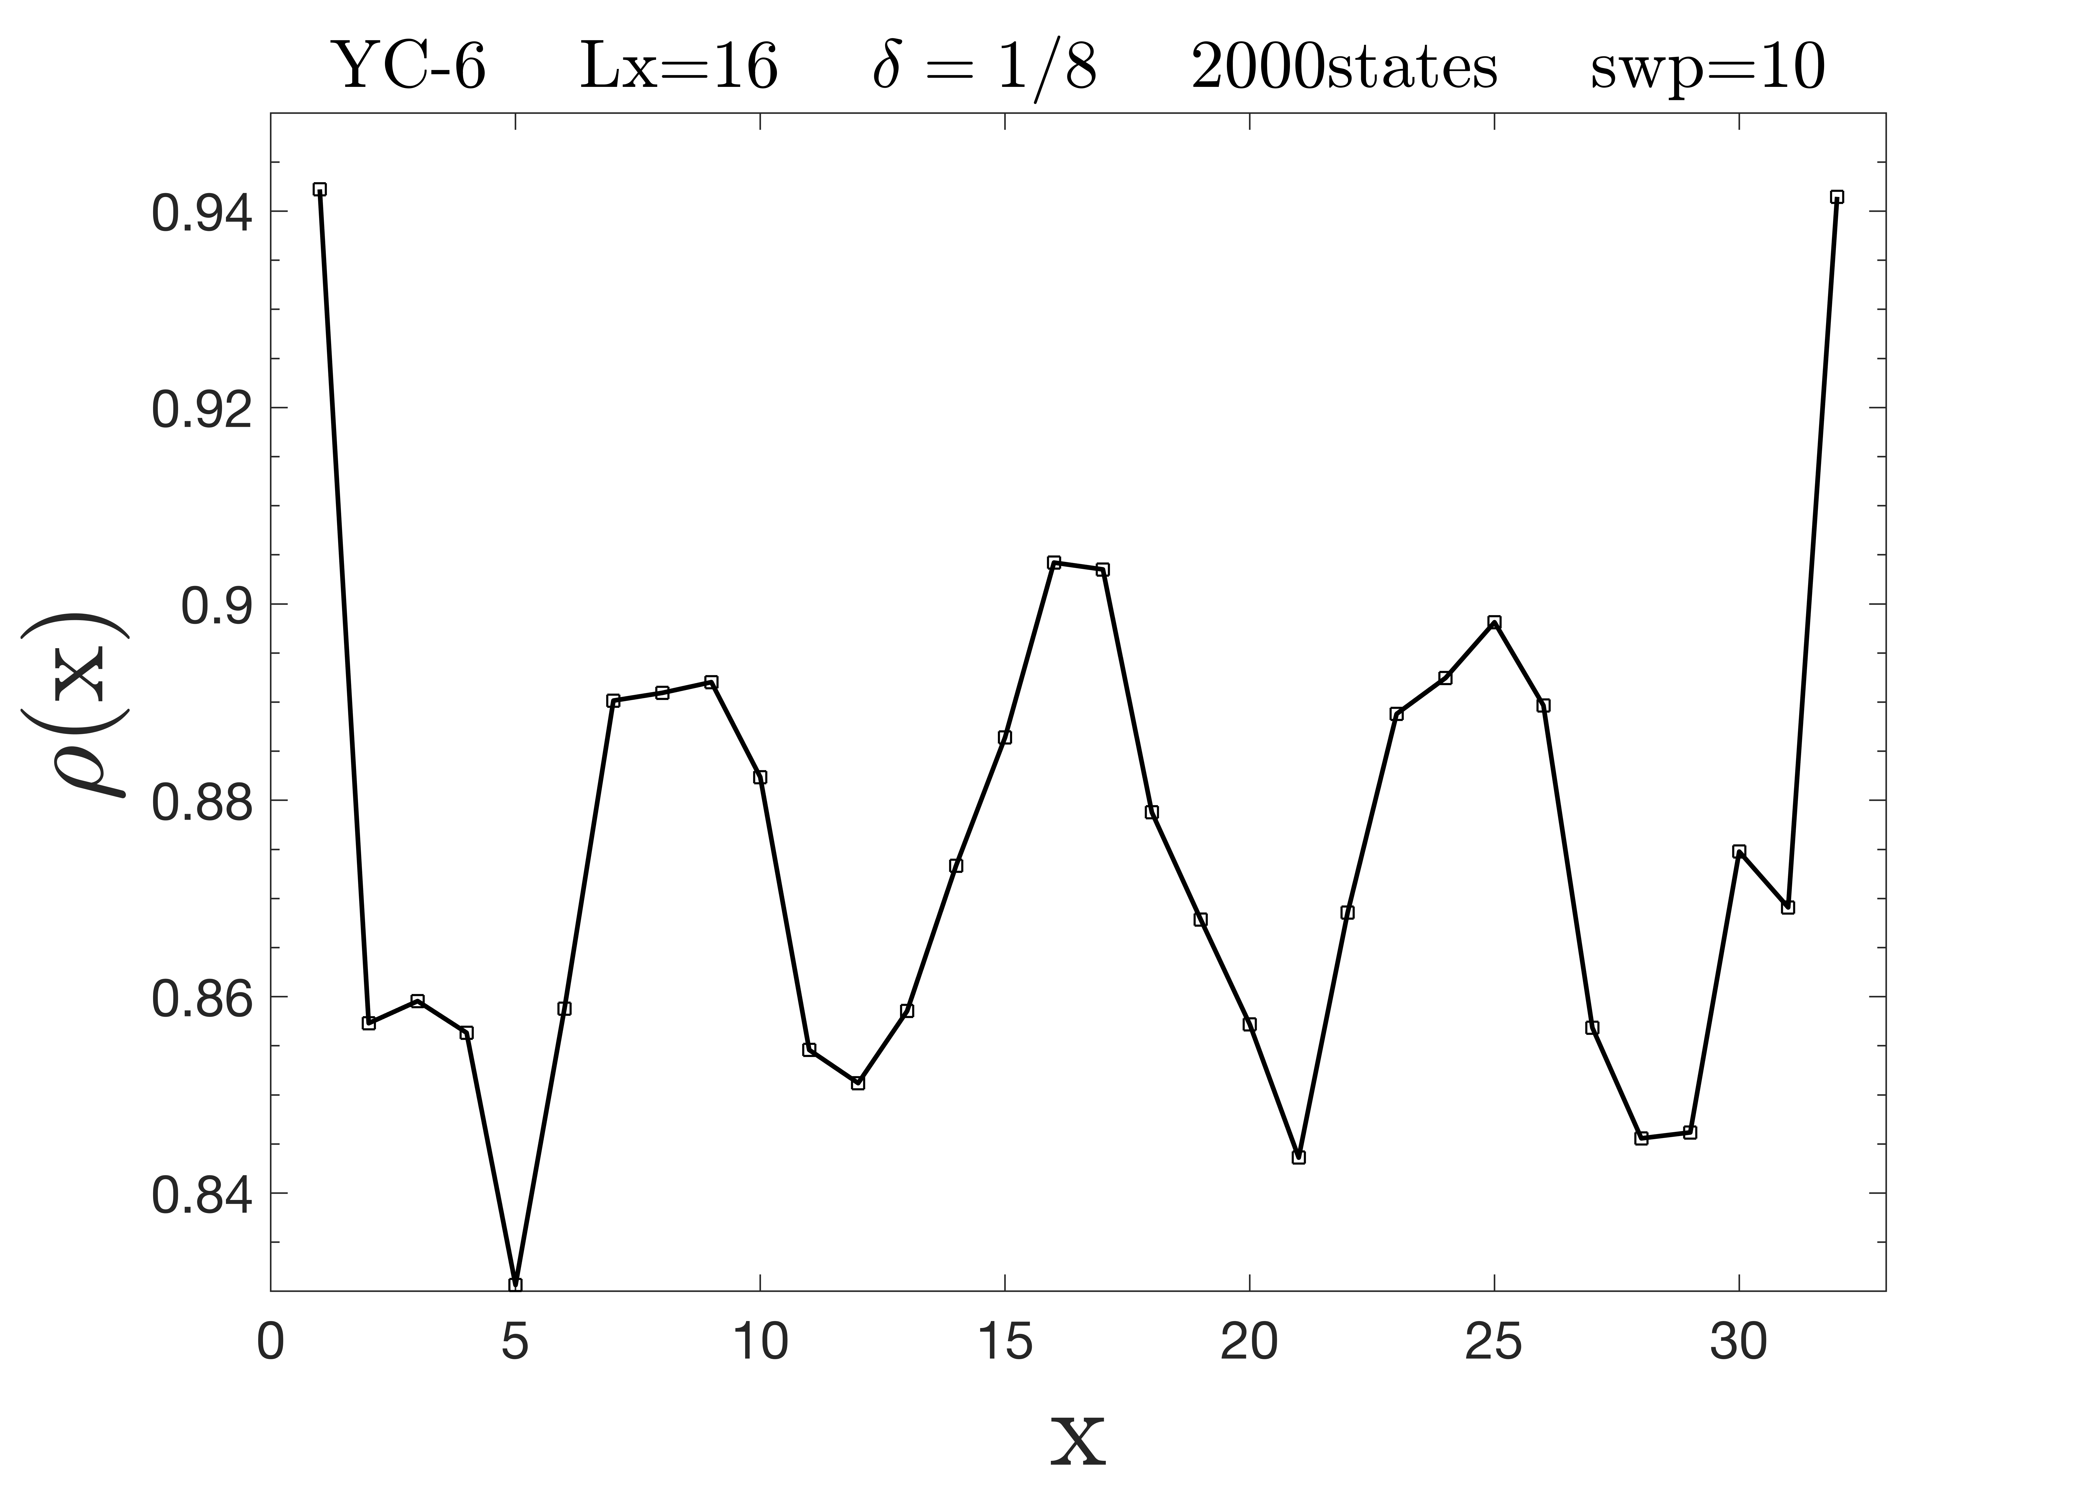

Slide 21
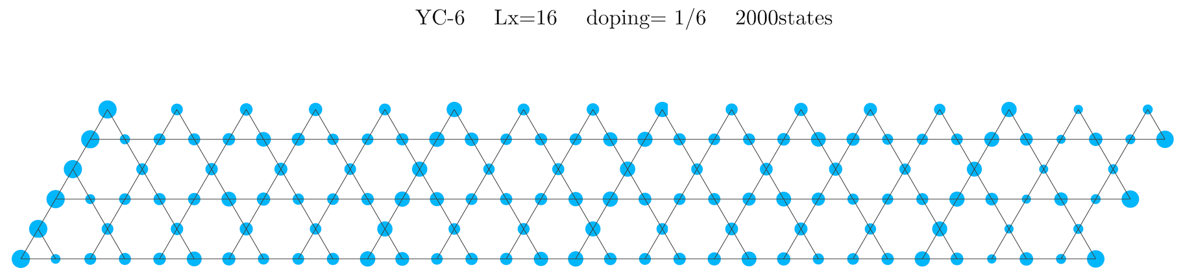
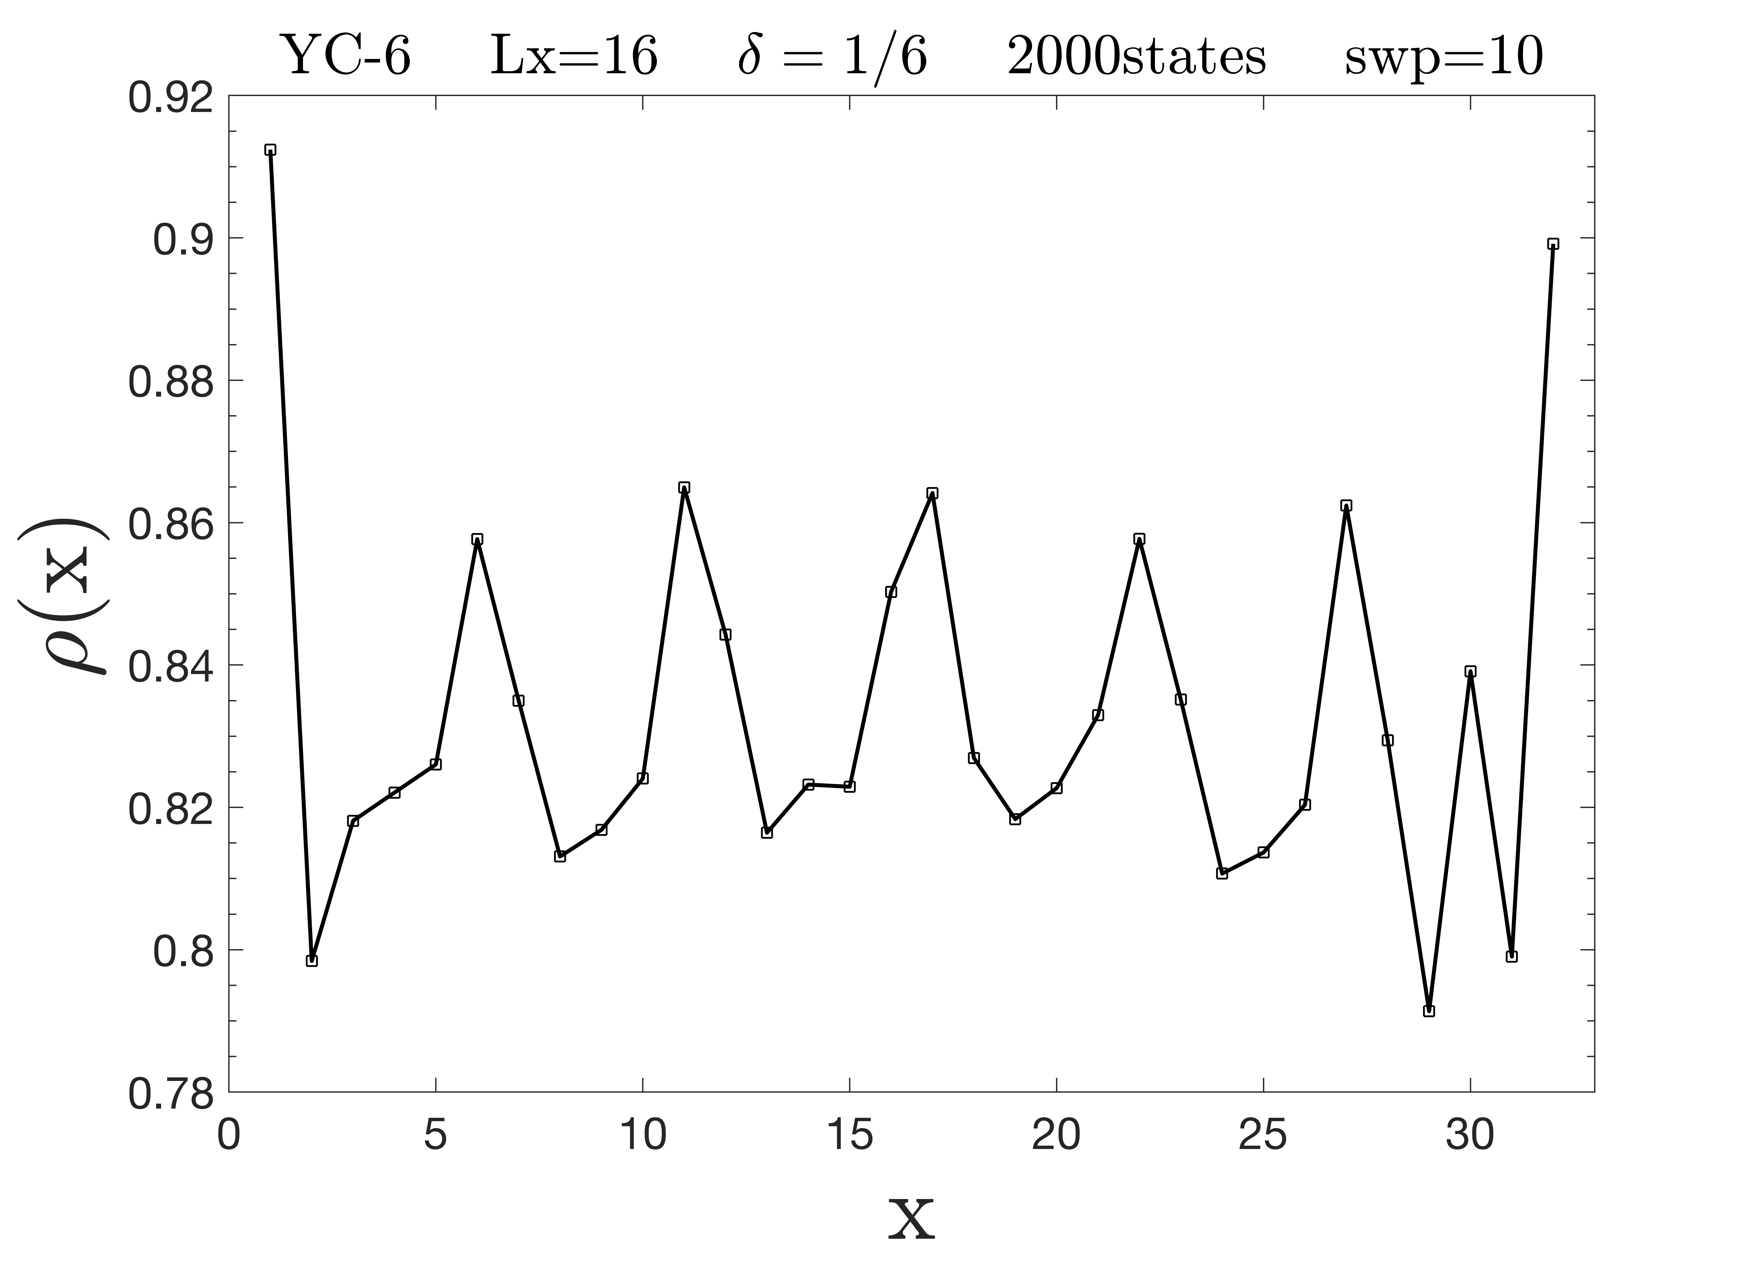
掺杂1/12，1/9时，y方向平移对称性破缺

Slide 22
superconductivity correlation（a-a bond）

Slide 23

超导关联量级在10-3到10-7之间，相比于原始t-J模型来说，衰减变慢

Slide 26
electron density : YC-6，Lx=16，doping=1/18，2000state，14sweep，rb37
t=0.5/1时，系统都具有y方向平移对称性，电子分布与t=3有差异(t变小时边界电子密度下降)，但CDW的周期都是4，振幅也都是0.01左右

Slide 27
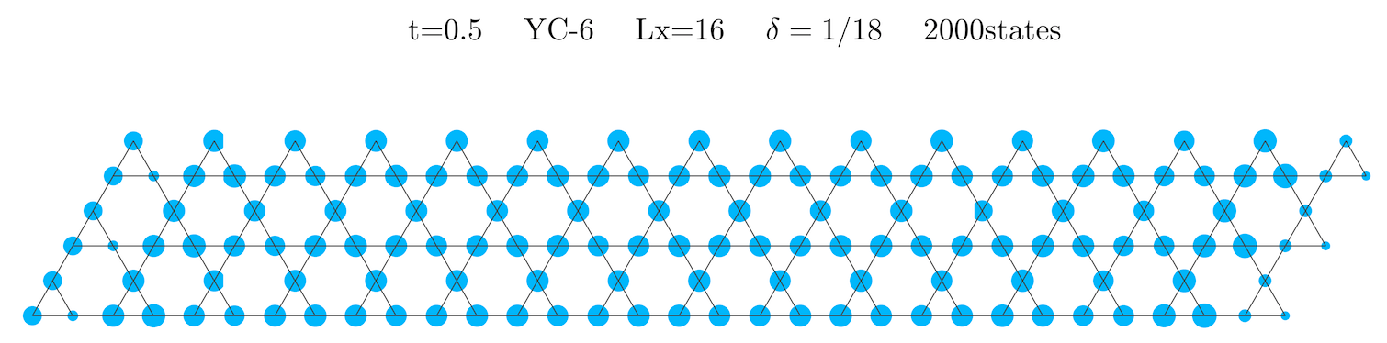
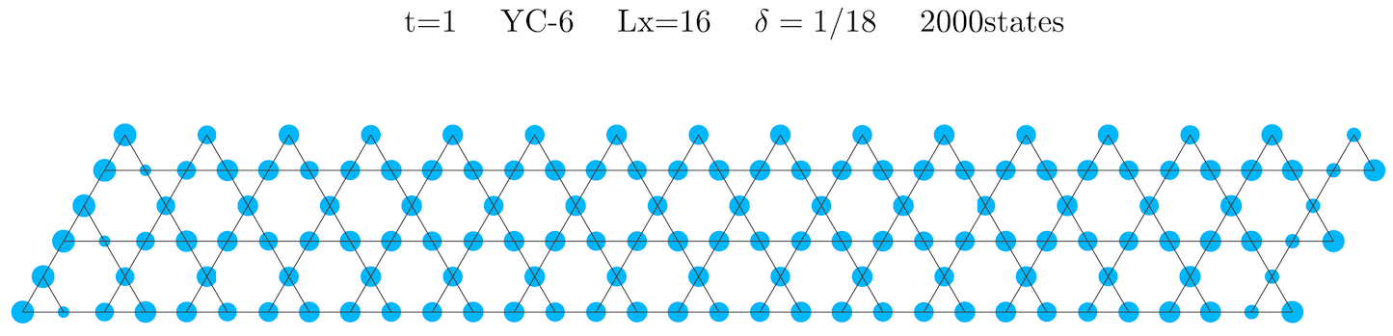

Slide 28
t=2/3/5时，系统都具有y方向平移对称性，电子分布非常相似

Slide 29
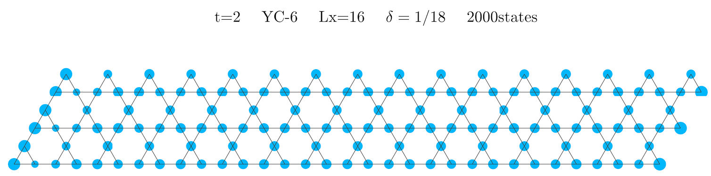
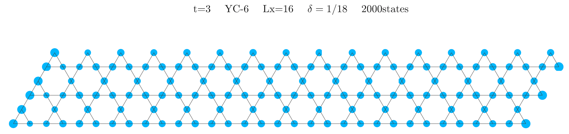
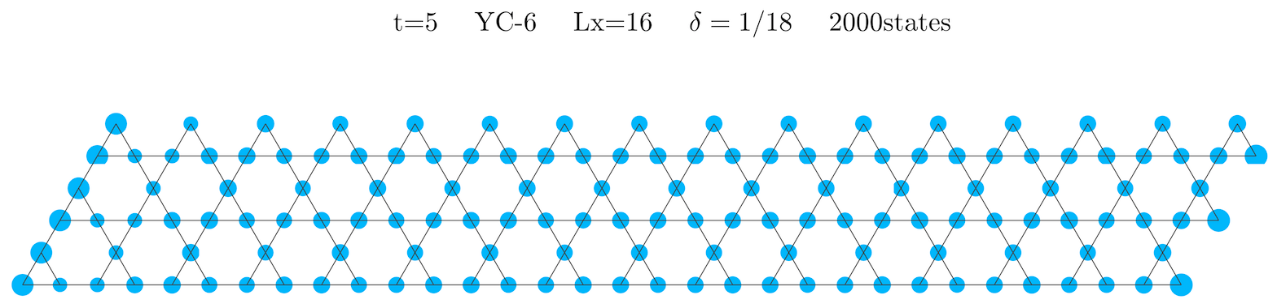

Slide 30
t=7/10时，系统都具有y方向平移对称性，电子分布与t=3有差异(t变大时边界电子密度上升)，但CDW的周期都是4，振幅也都是0.01左右

Slide 31
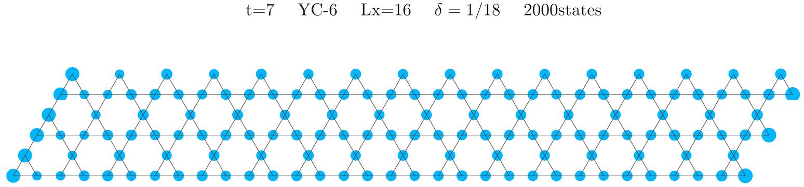
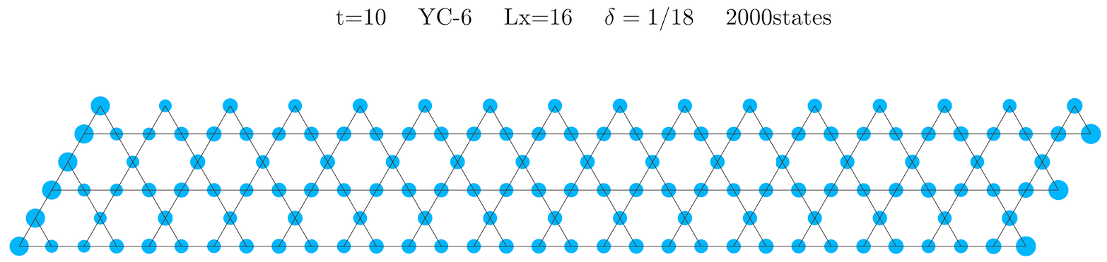

Slide 32
superconductivity correlation
如果t=0时，变回自旋J1-J2模型，超导关联仍然如此吗？

Slide 33
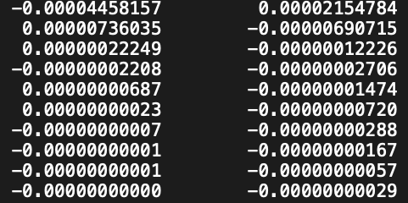
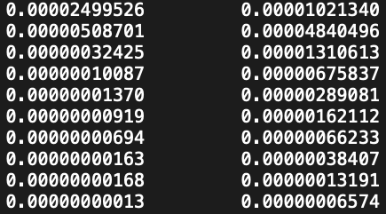

bb bond
ba bond
t=5
ab bond
aa bond
cb bond
cc bond

Slide 34



Slide 35



Slide 36




Slide 37





Slide 38



判断：
存在CDW，满足y方向平移对称，但CDW振幅变强很多，可能意味着抑制超导

Slide 39
t=3 t2/t=0.7
判断：超导关联相对于t2/t>0大幅下降，decay速度提高了约5个量级

Slide 40


t=3 J=1 YC-6 Lx=16 δ=1/18

Slide 41



Slide 43



Slide 45



判断：
随着引入J2，总体来说CDW被抑制了
基本满足y方向平移对称性

Slide 46
判断：超导关联衰减提高了几个量级，结果近似t2/t=0.7,J2=049

Slide 49
判断：超导关联衰减提高了几个量级，但比t2/t=0.7,J2=049稍差；y方向满足平移对称性，CDW的振幅随着J2增大而减小，被抑制了。从1.5-3，则明显发生相变，超导关联迅速消失，电荷分布混乱

Slide 52



Slide 54
没有J2的时候，CDW振幅类似，超导关联函数的量级基本相同
加负的J2后，超导关联函数变弱

Slide 55


Slide 57



Slide 59



Slide 60
判断：t2/t=0.3 J2<0时，结果都基本满足y方向上平移对称性。电子分布出现了很奇怪的鼓包

Slide 61




Slide 62
判断：超导关联衰减提高了不到2个量级，结果与最开始t2/t=0.7，J2=0.49的结果非常相似。y方向满足平移对称性，CDW的振幅减小了

Slide 64



Slide 65
判断：加负的J2后，超导关联函数出现了不规则的衰减，但总体变弱

Slide 67



Slide 69



Slide 70
判断：t2/t=0.7,J2<0时，y方向基本满足平移对称性。电子密度出现了类似的鼓包，但是振荡更加剧烈

Slide 71



Slide 72



Slide 73
2000states
3000states

Slide 74

2000states
3000states

Slide 75
判断：计算结果的奇异特征应该不是计算精度不够导致，计算是基本可靠的

Slide 76
判断：在t2/t=0.7时，加不加J2基本没有影响

Slide 78



Slide 79
判断：在J2=0.49的情况下，加入t2到0.7之后，超导关联提高了3个量级，CDW也被抑制了

Slide 82



